Slide 1
Control Unit We will review the entire course in this lecture
Dr. John P. Abraham
UTRGV

Slide 2
Processor Design steps
1. Create Instruction set (which you did early in the semester)
Each instruction (ISA) will need to be transformed to Register Transfer Language (RTL)
Design datapath that support each register transfer and memory storage. Align with clocking.
Create a management mechanism (control unit) to coordinate activities.

Slide 3
Control unit Coordinates all activities of instruction execution
Generates control signals based on instruction being executed
At the core of all computers is a control unit. The control unit provides mechanisms to procedurally step through instructions.
Before the invention of control unit a computer can only run one program based on wiring and output lights.
To run a different program wiring had to changed which took weeks

Slide 4
Early Computers
It is worthwhile to note that stored program concept was proposed by John von Neumann (1945 draft). The Von Neumann architecture uses a shared memory and bus for both data and instructions whereas the Harvard architecture has physically separate memories for instructions and data
Until then computer programming was accomplished by setting internal wires of a computer. To change a program the wires had to be redone.
In stored program concept instructions can produce control signals. ENIAC, the stored program computer was introduced in 1948.
The point I am trying to make is that a computer can be programmed by changing wires (very tedious and most expensive) or by storing instructions in memory.

Slide 5
Control Unit
A component within a CPU.
Control unit is responsible for carrying out the instructions in a given program.
It generates control signals required to move data and to carry out operations.
It has access to the general purpose registers as well as specialized registers contained in the CPU such as the PC, IR, IBR, MBR, MAR, Cache, status register, etc. It also has access to the ALU. We learned the operation during the first 3 weeks of this course.

Slide 6
Control Unit

Slide 7
Brief Recap
PC contains the address of the next instruction to be executed.
Contents of the PC is copied to MAR and the control unit issued proper control signals to read the RAM memory.
The memory places its contents onto the data bus which is connected to MBR
Word from MBR is moved to IR and additional instructions fetched are moved to IBR.
Binary instruction is made into fields based on the type of instruction thus decoded.
Based on the decoded fields, different signals are produced by the control unit and placed on the datapath at the appropriate clock cycle.

Slide 8
Two designs of control unit
Hardwired (combinational circuits)
Inflexible, but fast. good for RISC
Microprogrammed (software controlled) Good for CISC
Very flexible. Program can easily be changed
Can add or delete to instruction set
Since each line of code needs to be executed to generate code it is slower

Slide 9
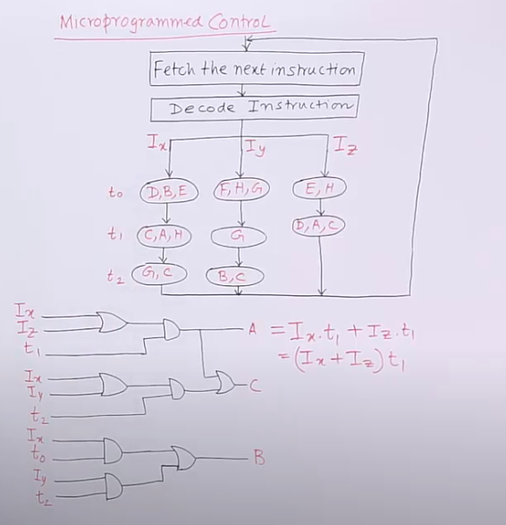

Slide 10
Micro operations Instruction from IR goes to CMAR which is broken down to many micro instructions. See Wilkes Control Unit. All microinstruction routines are kept in Control Unit ROM memory

Slide 11
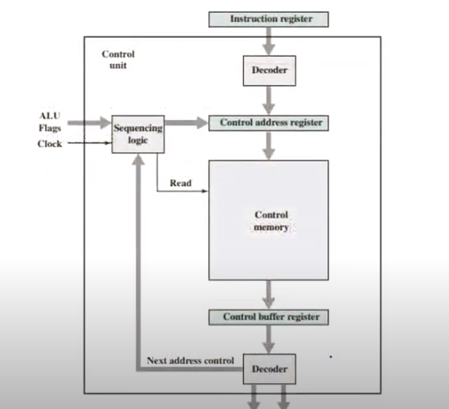
To CPU bus | To System Bus

Slide 12
Control signals
Let’s us use a memory example
MAR contains memory address that needs to be manipulated.
This address needs to be placed on the address bus as signals provided by the control unit
Now the control bus should get a read enable or write enable control signal as provided by the control unit
Data-bus needs be enabled or disabled depending on control signals produced by control unit

Slide 13
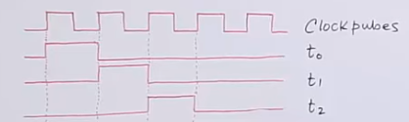
Clock cycle
In each clock cycle one micro operation can be performed. For example, t0 may be MAR⬅PC and at t1 IR← Mem[MAR]. Generally clock cycles go from t0 to t16, then starts over.

Slide 14
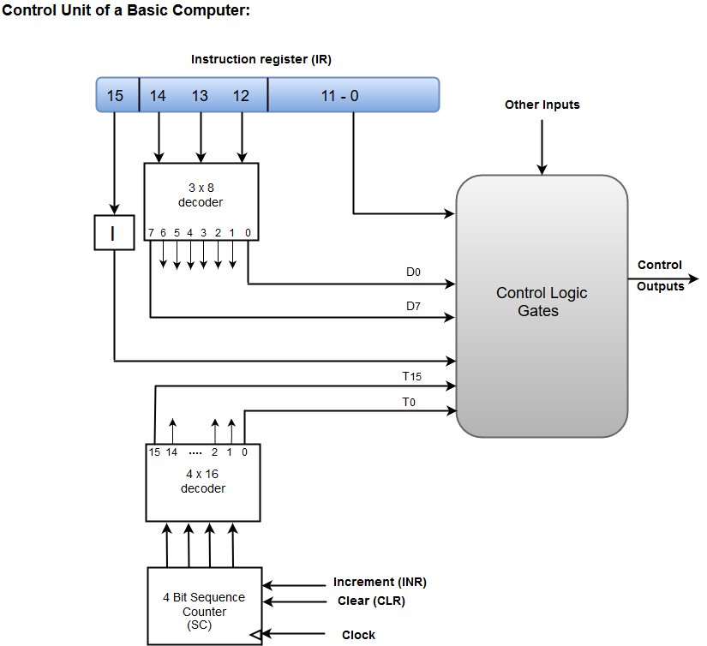
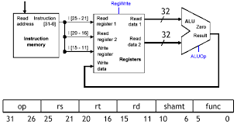
Add R1, R1, R2
rd
rd
c1
c2
R1
R2
c3
c4
wr
ALU
C5 Add
c6
MIPS control unit

Slide 15
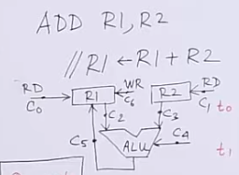
Everything labeled C0 to c6 are control signals.
1. Place both R1 and R2 in Read mode (c0, c1).
2. Make datapaths available to ALU (c2, c3). 3. Enable ALU to do the operation (C4)
4. Enable datapath from ALU output to R1 (c5). 5. Place R1 in Write mode (c6)

Slide 16
Operation add t1,t1,t2 I placed the sequence of control signals in []
There are two input registers t1 and t2
There is one output register t1
Control unit places t1 [1] and t2 [2] in read mode (RD) through the signals generated. Also datapaths [3,4] are enabled such that ALU will receive the two inputs. Also ALU [5] will get enabled through signals generated to do the appropriate operation. The result will be placed in t1, thus t1 should be placed in write (WR) mode [6].

Slide 17
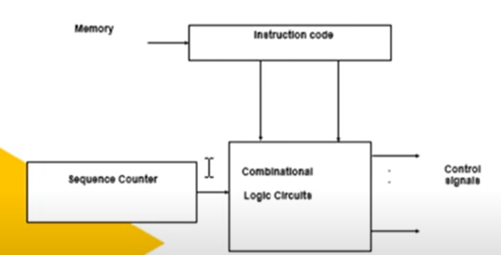
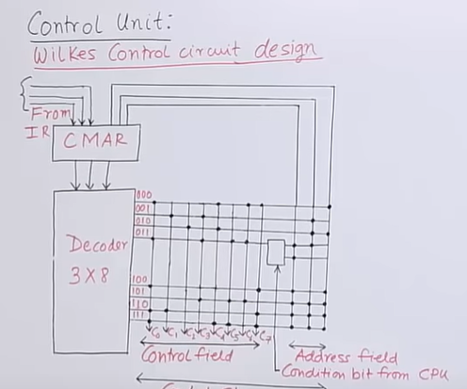
Hardwired Control Unit
Designed as a finite state machine
Faster than microprogrammed control unit
But, inflexible
3 ways of designing hardwired
State table method
Delay element method
Sequence counter method
One hardwired Method is known as Wilkes Control Circuit design

Slide 18
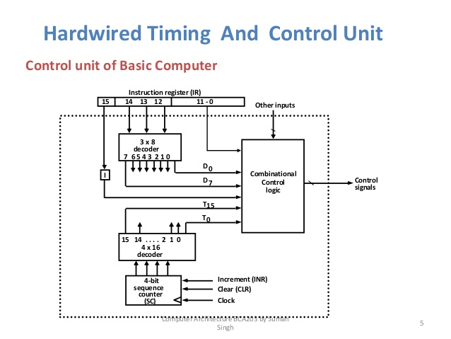
This slide is taken from Suman Singh, showing a 16 bit instruction with operands taking 12 bits, 3 bits assigned for opcode, and the most significant bit (15) is assigned for direct or indirect bit. The opcode input bits are connected to a decoder which can output 8 different signals, and activate one and only one of its 8 output lines. Each line corresponds to one of the instructions in the computer's instruction set. This combined with timing signals from the clock are sent to a combinational logic unit to give final control signals. Clock cycles are used to step through an instruction components.

